Slide 1
Radiodetection
RD7200 & RD8200 Features & Functions

Slide 2
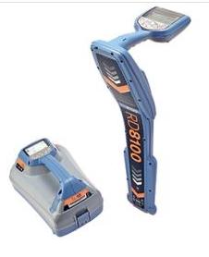
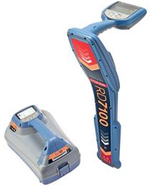
The Older Models
Water & Pipeline
Power
Construction
Telecom
RD8100
--
PDL / PDLG
PXL / PXLG
PTL / PTLG
RD7100
SL
DL / DLG
PL / PLG
TL / TLG
The RD7100 / RD8100 have been built on Radiodetection’s pedigree for performance, quality and durability.
Confident of our quality, we offer a 3 year warranty on our precision locator range

Slide 3
The New Models
We listen to your wants, needs and suggestions and work to develop the best solutions for todays business …..and tomorrows!

Slide 4
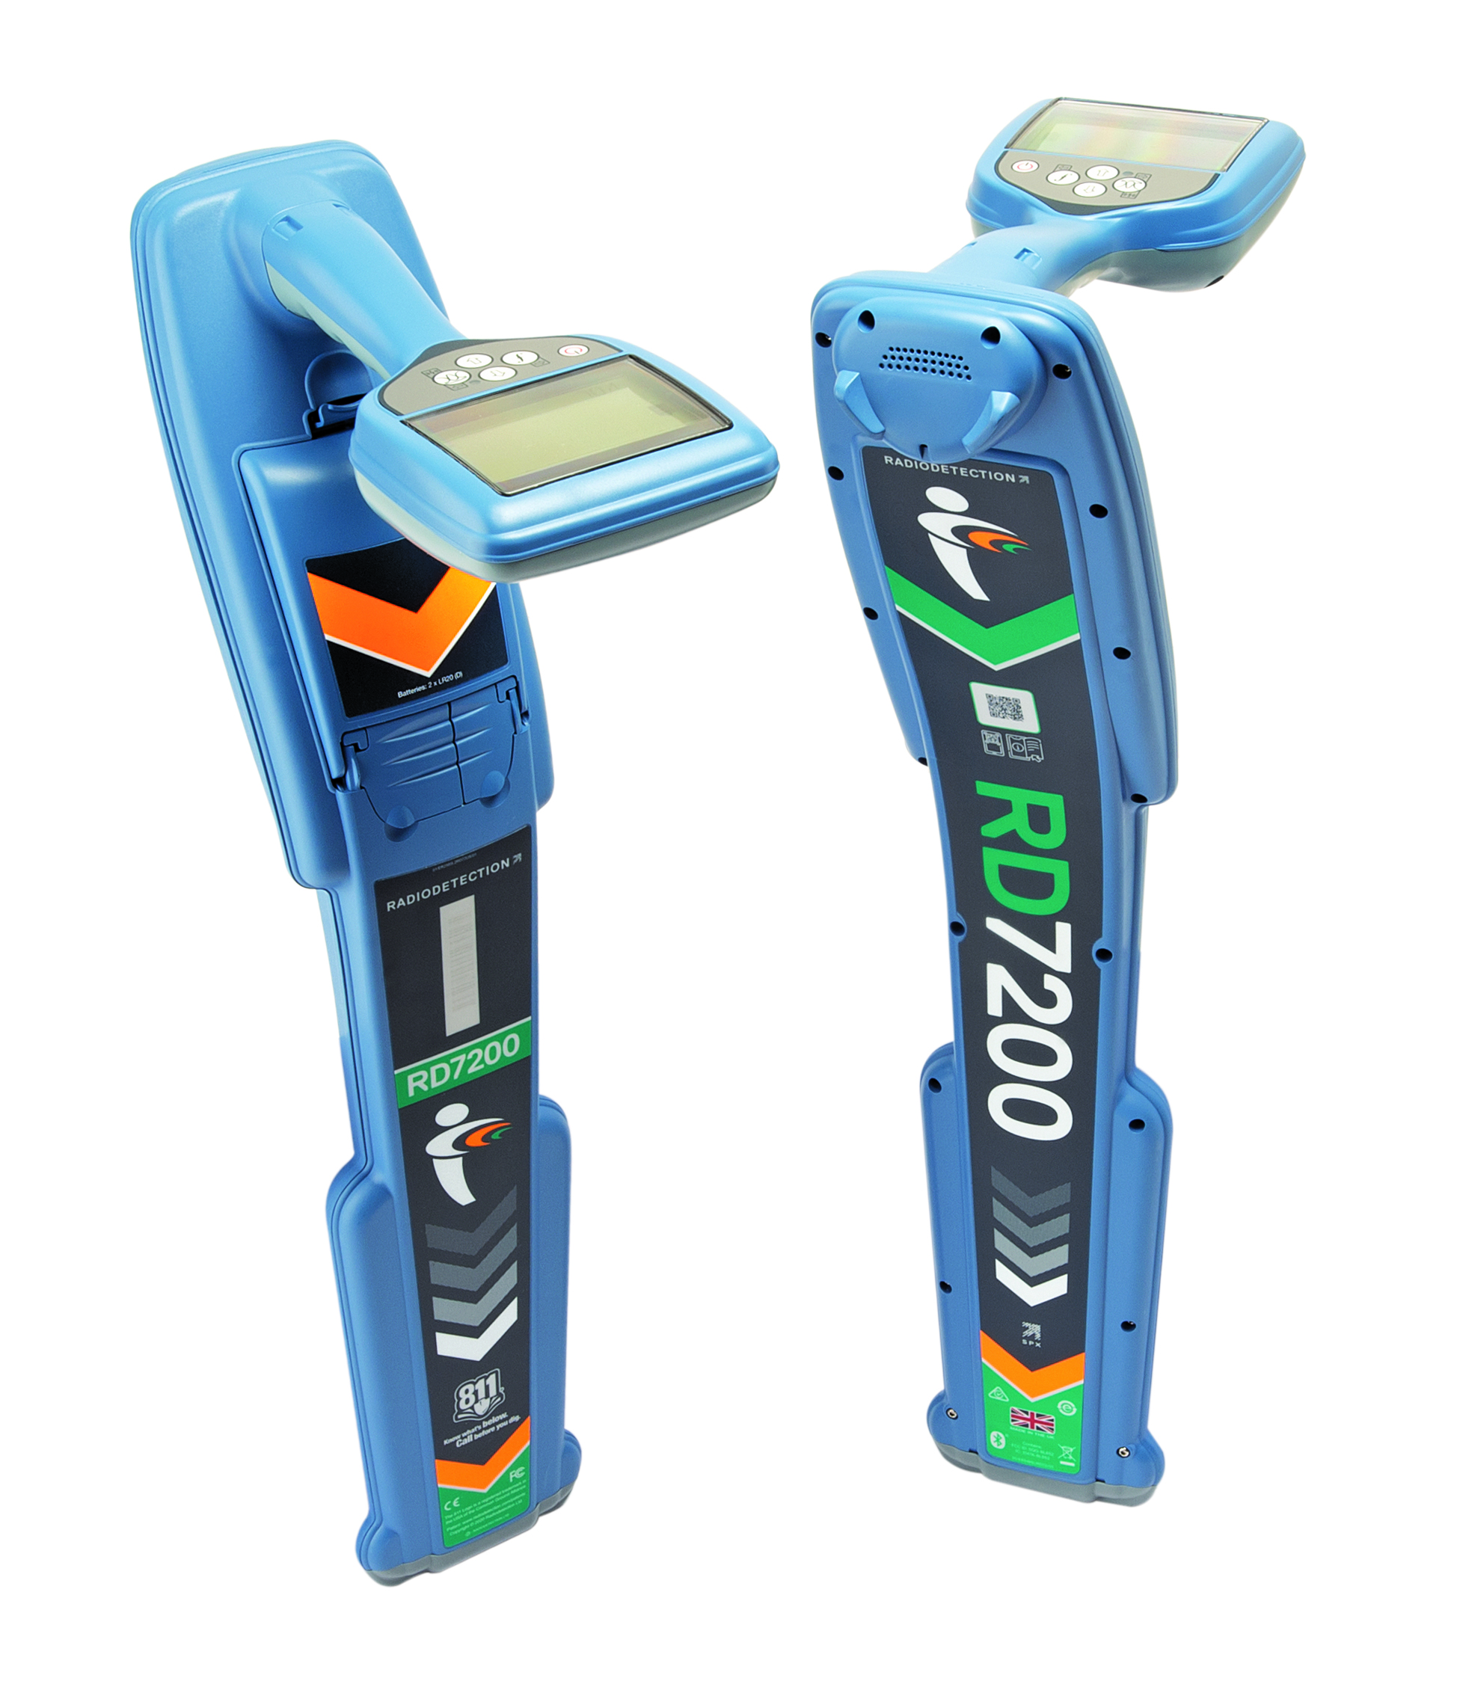
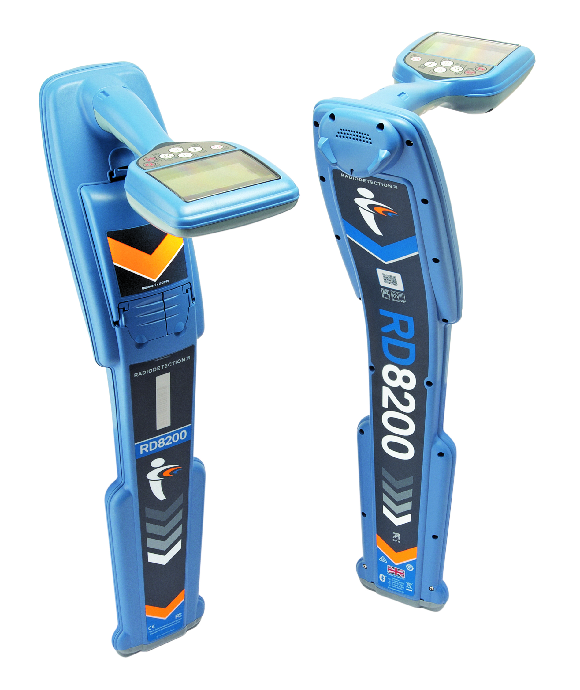
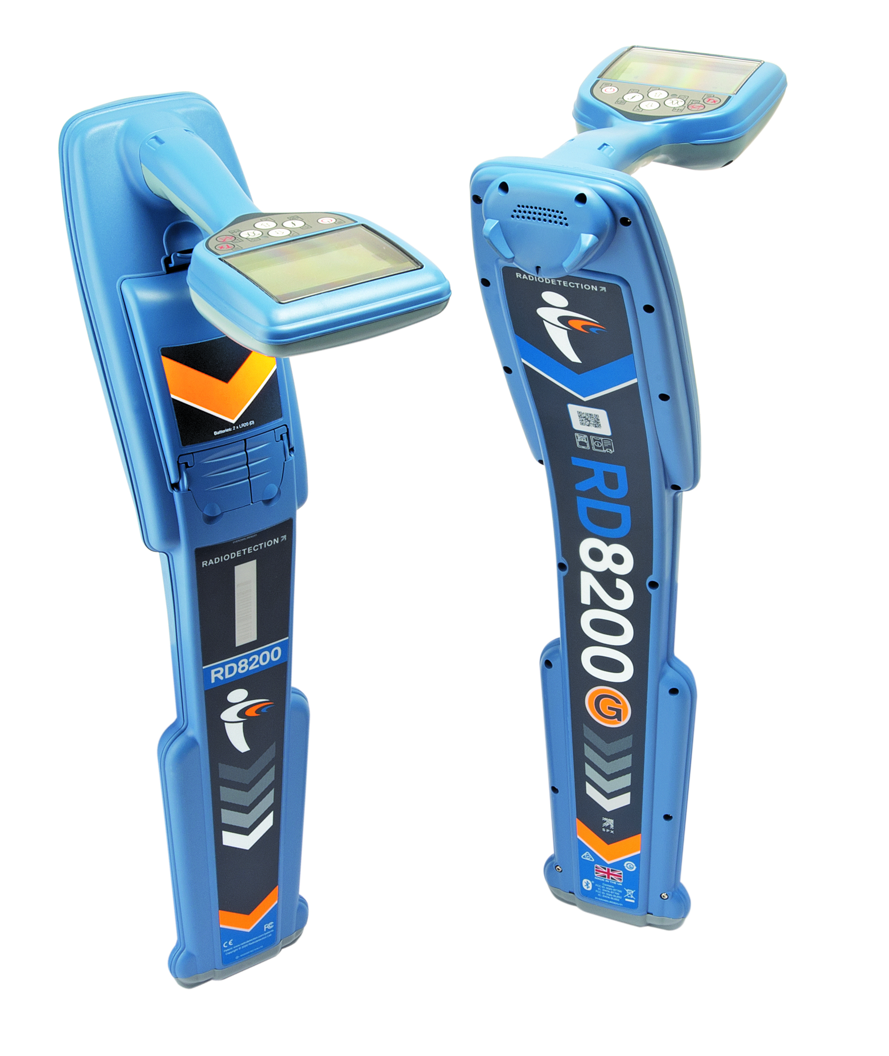
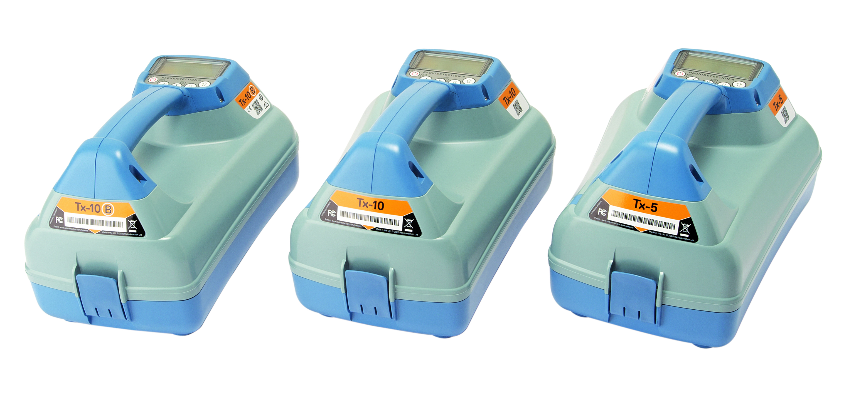
The New Models
RD7200
RD8200
RD8200G
Tx-5 Tx-10 Tx-10B
13 Locator models rolled into 3

Slide 5
The New Models
The Features, Functions & Frequencies of “all” RD8100 models are now included in the RD8200/RD8200G
(G units have internal GPS)
The Features, Functions and Frequencies of “all” RD7100 models are now included in the RD7200
Transmitters are reduced to 3 models
RD8200G
RD8200
RD7200
Making model selection easier for the end user
Tx-5 Tx-10 Tx-10B

Slide 6
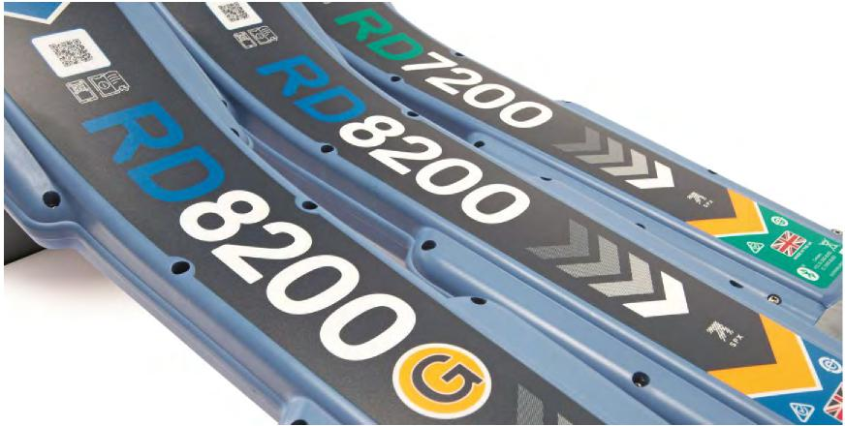
Building On Our Strengths
Building on the strengths of the existing range:
Light weight (4.0 lbs/2.2kg with Li-ion battery)
High visibility all weather display
Outstanding ergonomic design
Sensitivity
Locate and depth accuracy
Ability to locate deep buried utilities (up to 98‘/30m)
Up to 22 active frequencies and 5 locate modes

Slide 7
Building On Our Strengths
Features and Functions you already know
RD8200/RD8200G
5 Antenna modes
Active & Passive Locating
Simultaneous depth and current readout
Strike alert
Self test
Side step
Internal GPS
Current direction
iLoc (Bluetooth control of the transmitter)
Harmonic power filters
Dynamic overload protection
eCert field calibration validation
CalSafe calibration control
Custom frequencies
Fault finding
Side step Auto
Usage-logging
…. And More
RD7200
4 Antenna modes
Active & Passive Locating
Simultaneous depth and current readout
Strike alert
Self test
Dynamic overload protection
eCert field calibration validation
CalSafe calibration control
Fault finding
Ergonomic design
Compass
…. And More
Extended Warrantee & Local support

Slide 8
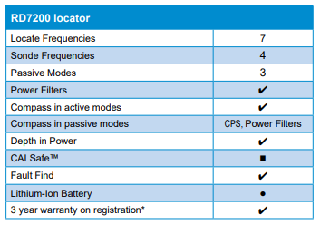
RD7200
Multi-function Multi-industry Locating
The RD7200 – accurate locating across multiple industries
Making locating easy
Advanced features such as Compass, TruDepth™ and a broad range of locating frequencies make the RD7200 the perfect choice for all industries.
Construction
Power
Water and Pipeline
Telecom

Slide 9
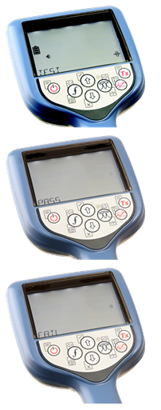
Self Test
Check accuracy and performance on-site
- display
- power
- integrity of measuring system
- integrity of locate circuitry
Accessed through the INFO menu
- displays ‘PASS’ or ‘FAIL’ on completion
Carry out test away from:
- large metallic object
- strong electrical signals
Battery level needs to be good
- will fail self test if battery is too low

Slide 10
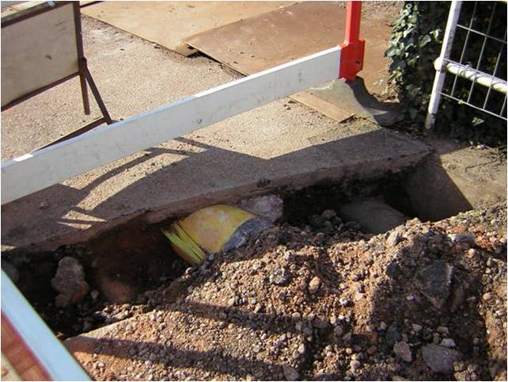
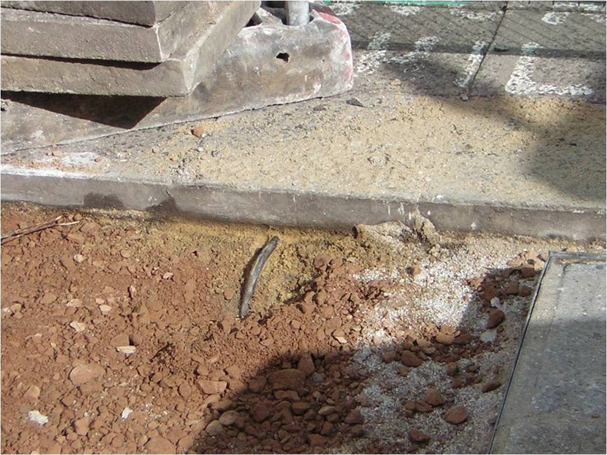
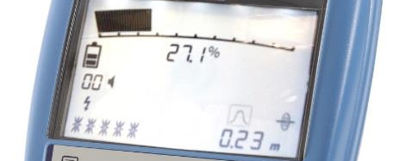
Strike Alert
Warns of shallow cables and pipes
Alerts on Power, Passive and Active
Alerts at approximately 30cm / 12”
Audible and visual alert
User can enable or disable on the locator or in RD Manager

Slide 11
Power Filters
Feature explanation
Power lines carrying a strong signal or buried closely together can create a broad wash of signal, which limits the ability to determine if there are one or more power lines. With a single key press, Power filters enables you to establish if a signal comes from one source, or from multiple power lines.
Benefit
Determine whether there are one or more power lines
Peace of mind you are locating correctly

Slide 12
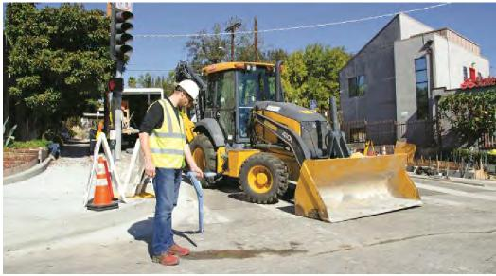
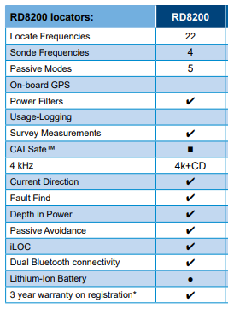
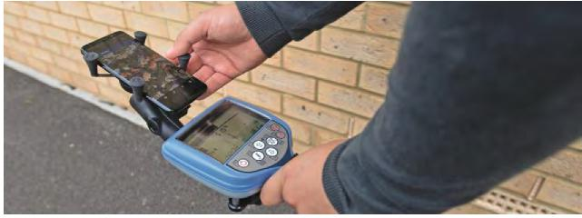
RD8200
When precision and accuracy matter most
Locate in congested areas and in the presence of strong interfering signals
Locating and tracing a specific utility in congested areas can be challenging. The RD8200 enables the field technician to confirm they are following the correct line, check for interference and avoid false positives, giving them confidence in the quality of their work
Produce cm-accurate utility maps
The demand for accurate utility maps is growing rapidly. The RD8200 precision locator can be connected with external GNSS systems, such as the Trimble Catalyst, and RD MAP+ to deliver cm-accurate maps

Slide 13
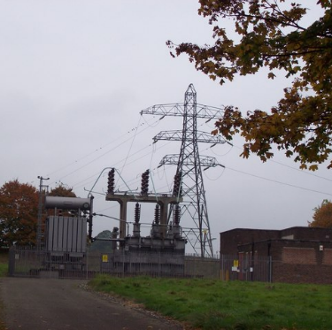
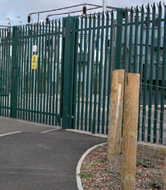
Dynamic Overload Protection
Enables locating in areas of electrical interference
Substations
HT cables
Rail / transportation infrastructure
Automatically senses interference and disregards it
Overload warning when strong interference cannot be corrected out – no depth or current readout
Invisible to operator, no input required, Shows as “Protected” in RD manager table.

Slide 14
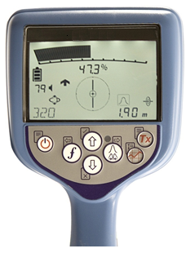
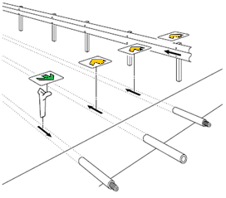
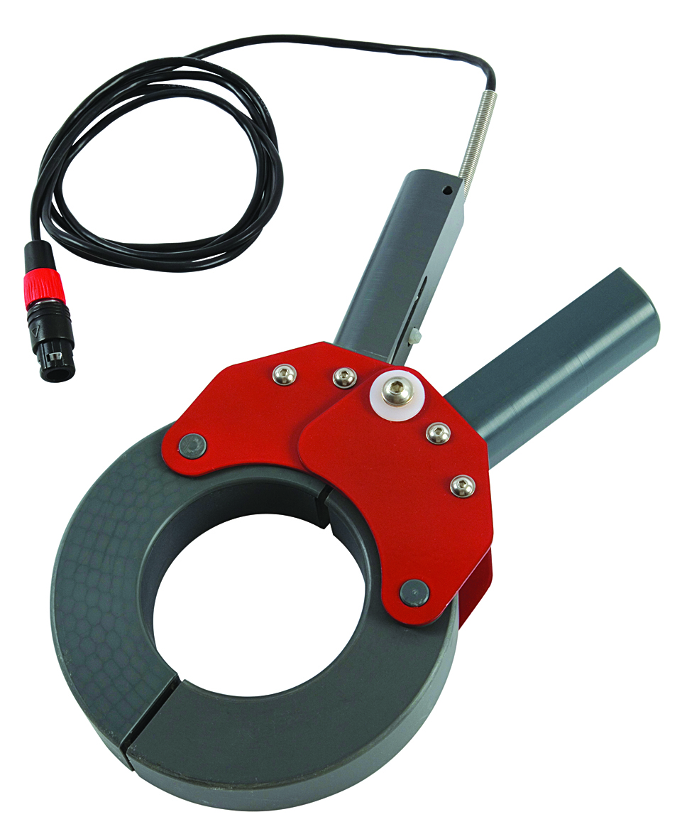
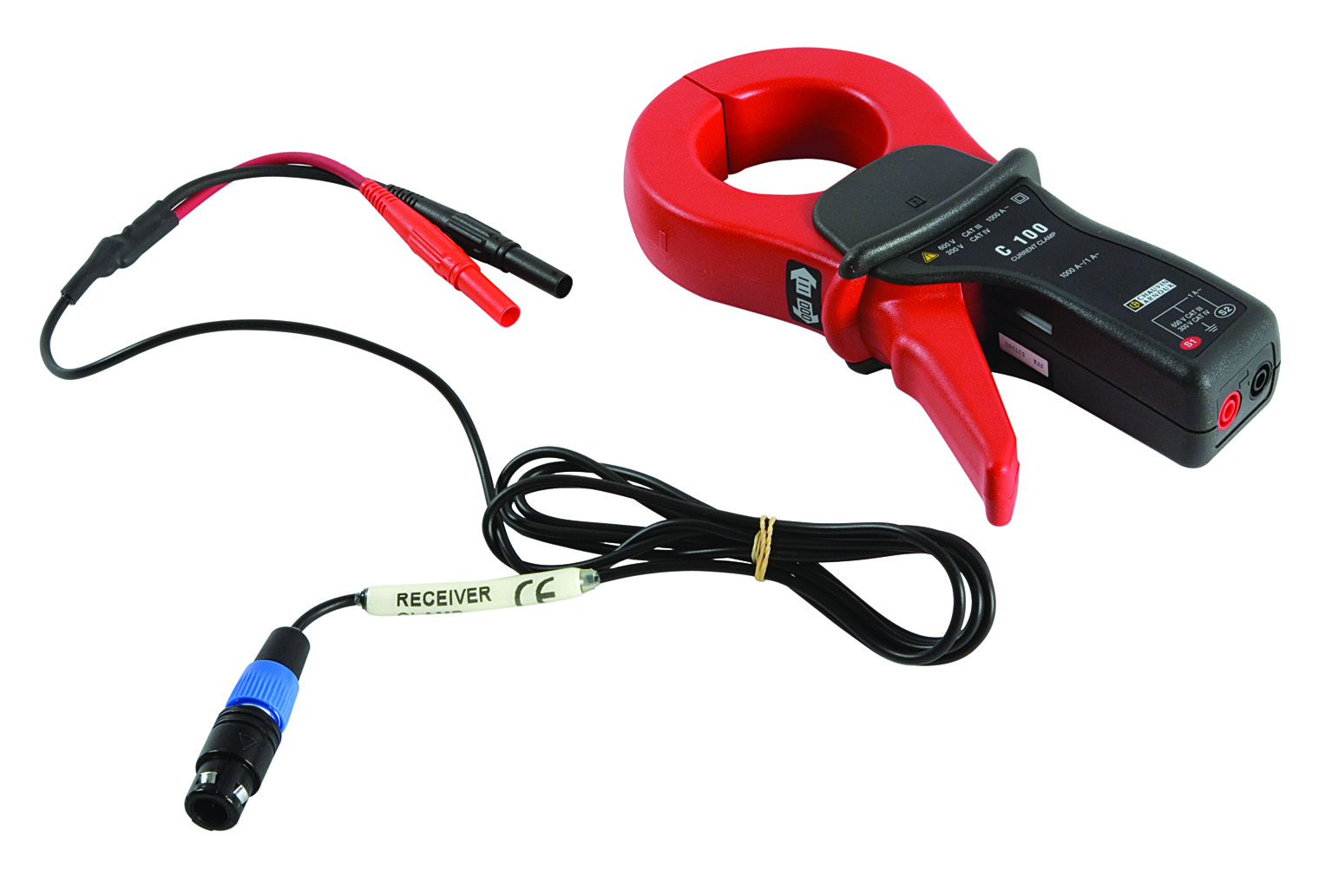
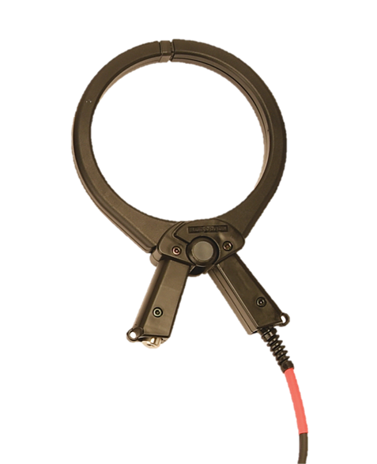
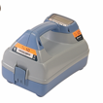
Current Direction
Locate Verification tool
Current Direction is a very good feature for identifying target lines
Apply using:
- direct connection
- clamp
Do a CD reset at start
- press and hold ‘f’ key (3 sec)
Current Direction Arrows

Slide 15
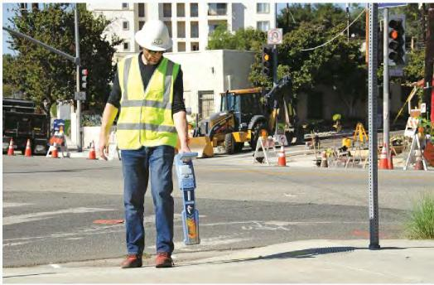
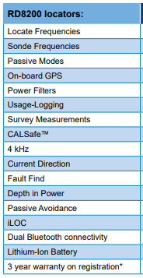
RD8200G
Reduction of damage to buried infrastructure contributes to:
Increased safety
Improved service integrity
Better cost control
Lower insurance liabilities
Enhanced reputation
When damage prevention
is at the heart of what you do
Follow these three steps:
Use the best available technology
The RD8200G is our most advanced locator. It enables technicians to carry out their job correctly and efficiently, regardless of complexity
Preventing damages to buried infrastructure is one of the biggest challenges for industry professionals.
Give your technicians expert training
Our comprehensive training programs can be tailored to your specific needs to ensure operators are fully proficient
Influence on-site behavior
The RD8200G records details on how, when and where it is used. Utilize this information to drive best-practice, identify training needs and maximize operator productivity

Slide 16
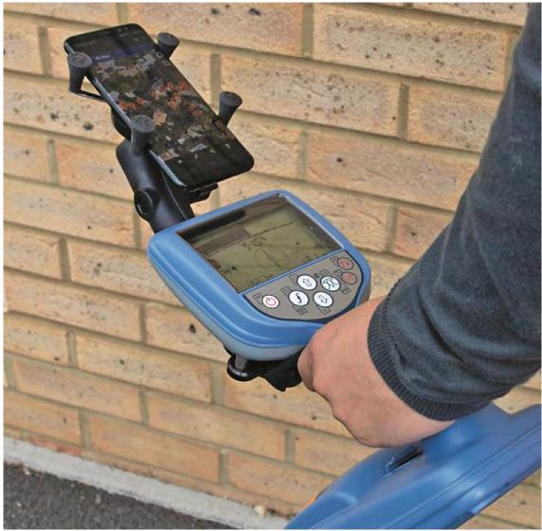
Advanced Features And Operations, Ready For A Connected World
The RD8200G system is a feature rich locating solution, designed to extend and future proof your field capabilities
RDMap™ +, for easy and cm accurate utility mapping
Dual Bluetooth connectivity, ready for a connected world
RD Manager for PC, for easy management of your RD8200
On-site monitoring
Integrated GPS and multi-rate automatic usage-logging allow managers to review locate history to ensure compliance with best practice

Slide 17
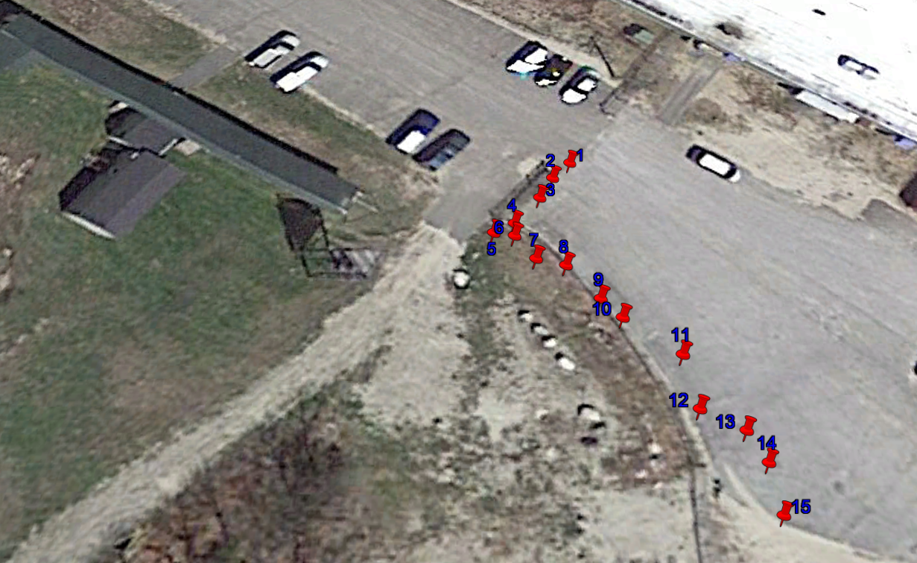
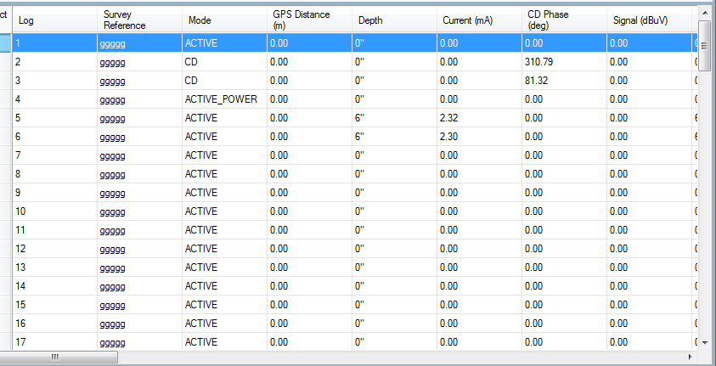
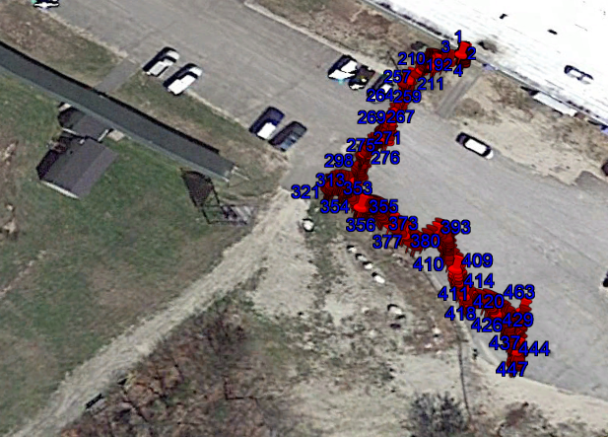
Updated RD Manager PC software
Locator Software updates
eCert calibration
Custom Frequencies
Survey measurements
Usage logging
Data Analysis
Export Locate & Usage logging data to Google earth

Slide 18
You asked for some changes
…We made that happen!

Slide 19
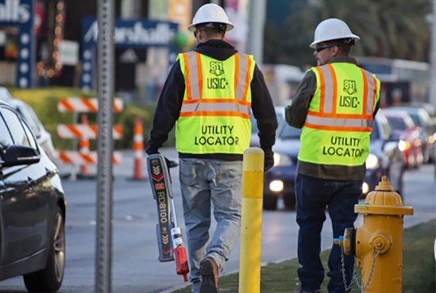
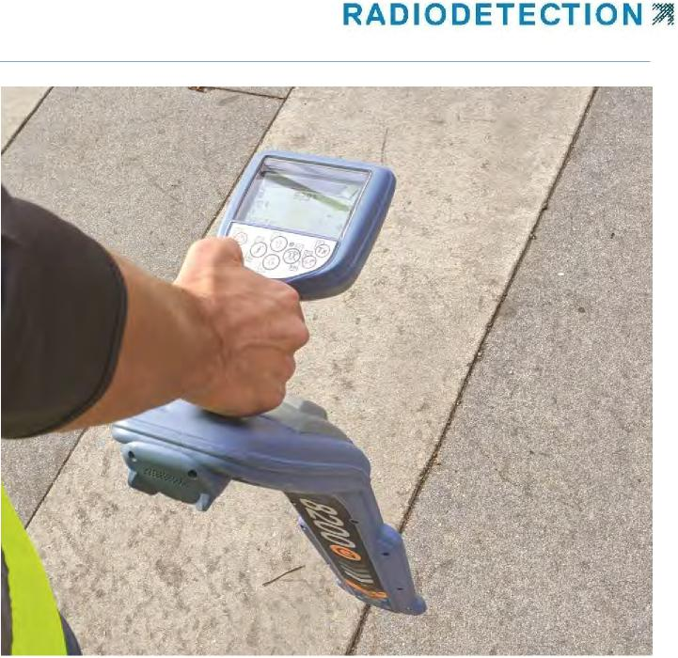
Safety Is Our Priority
Noisy urban environments where background ambient noise is loud
Safe operations and space awareness while focussing on the task
Lightweight, with balanced ergonomics must continue to be a priority

Slide 20
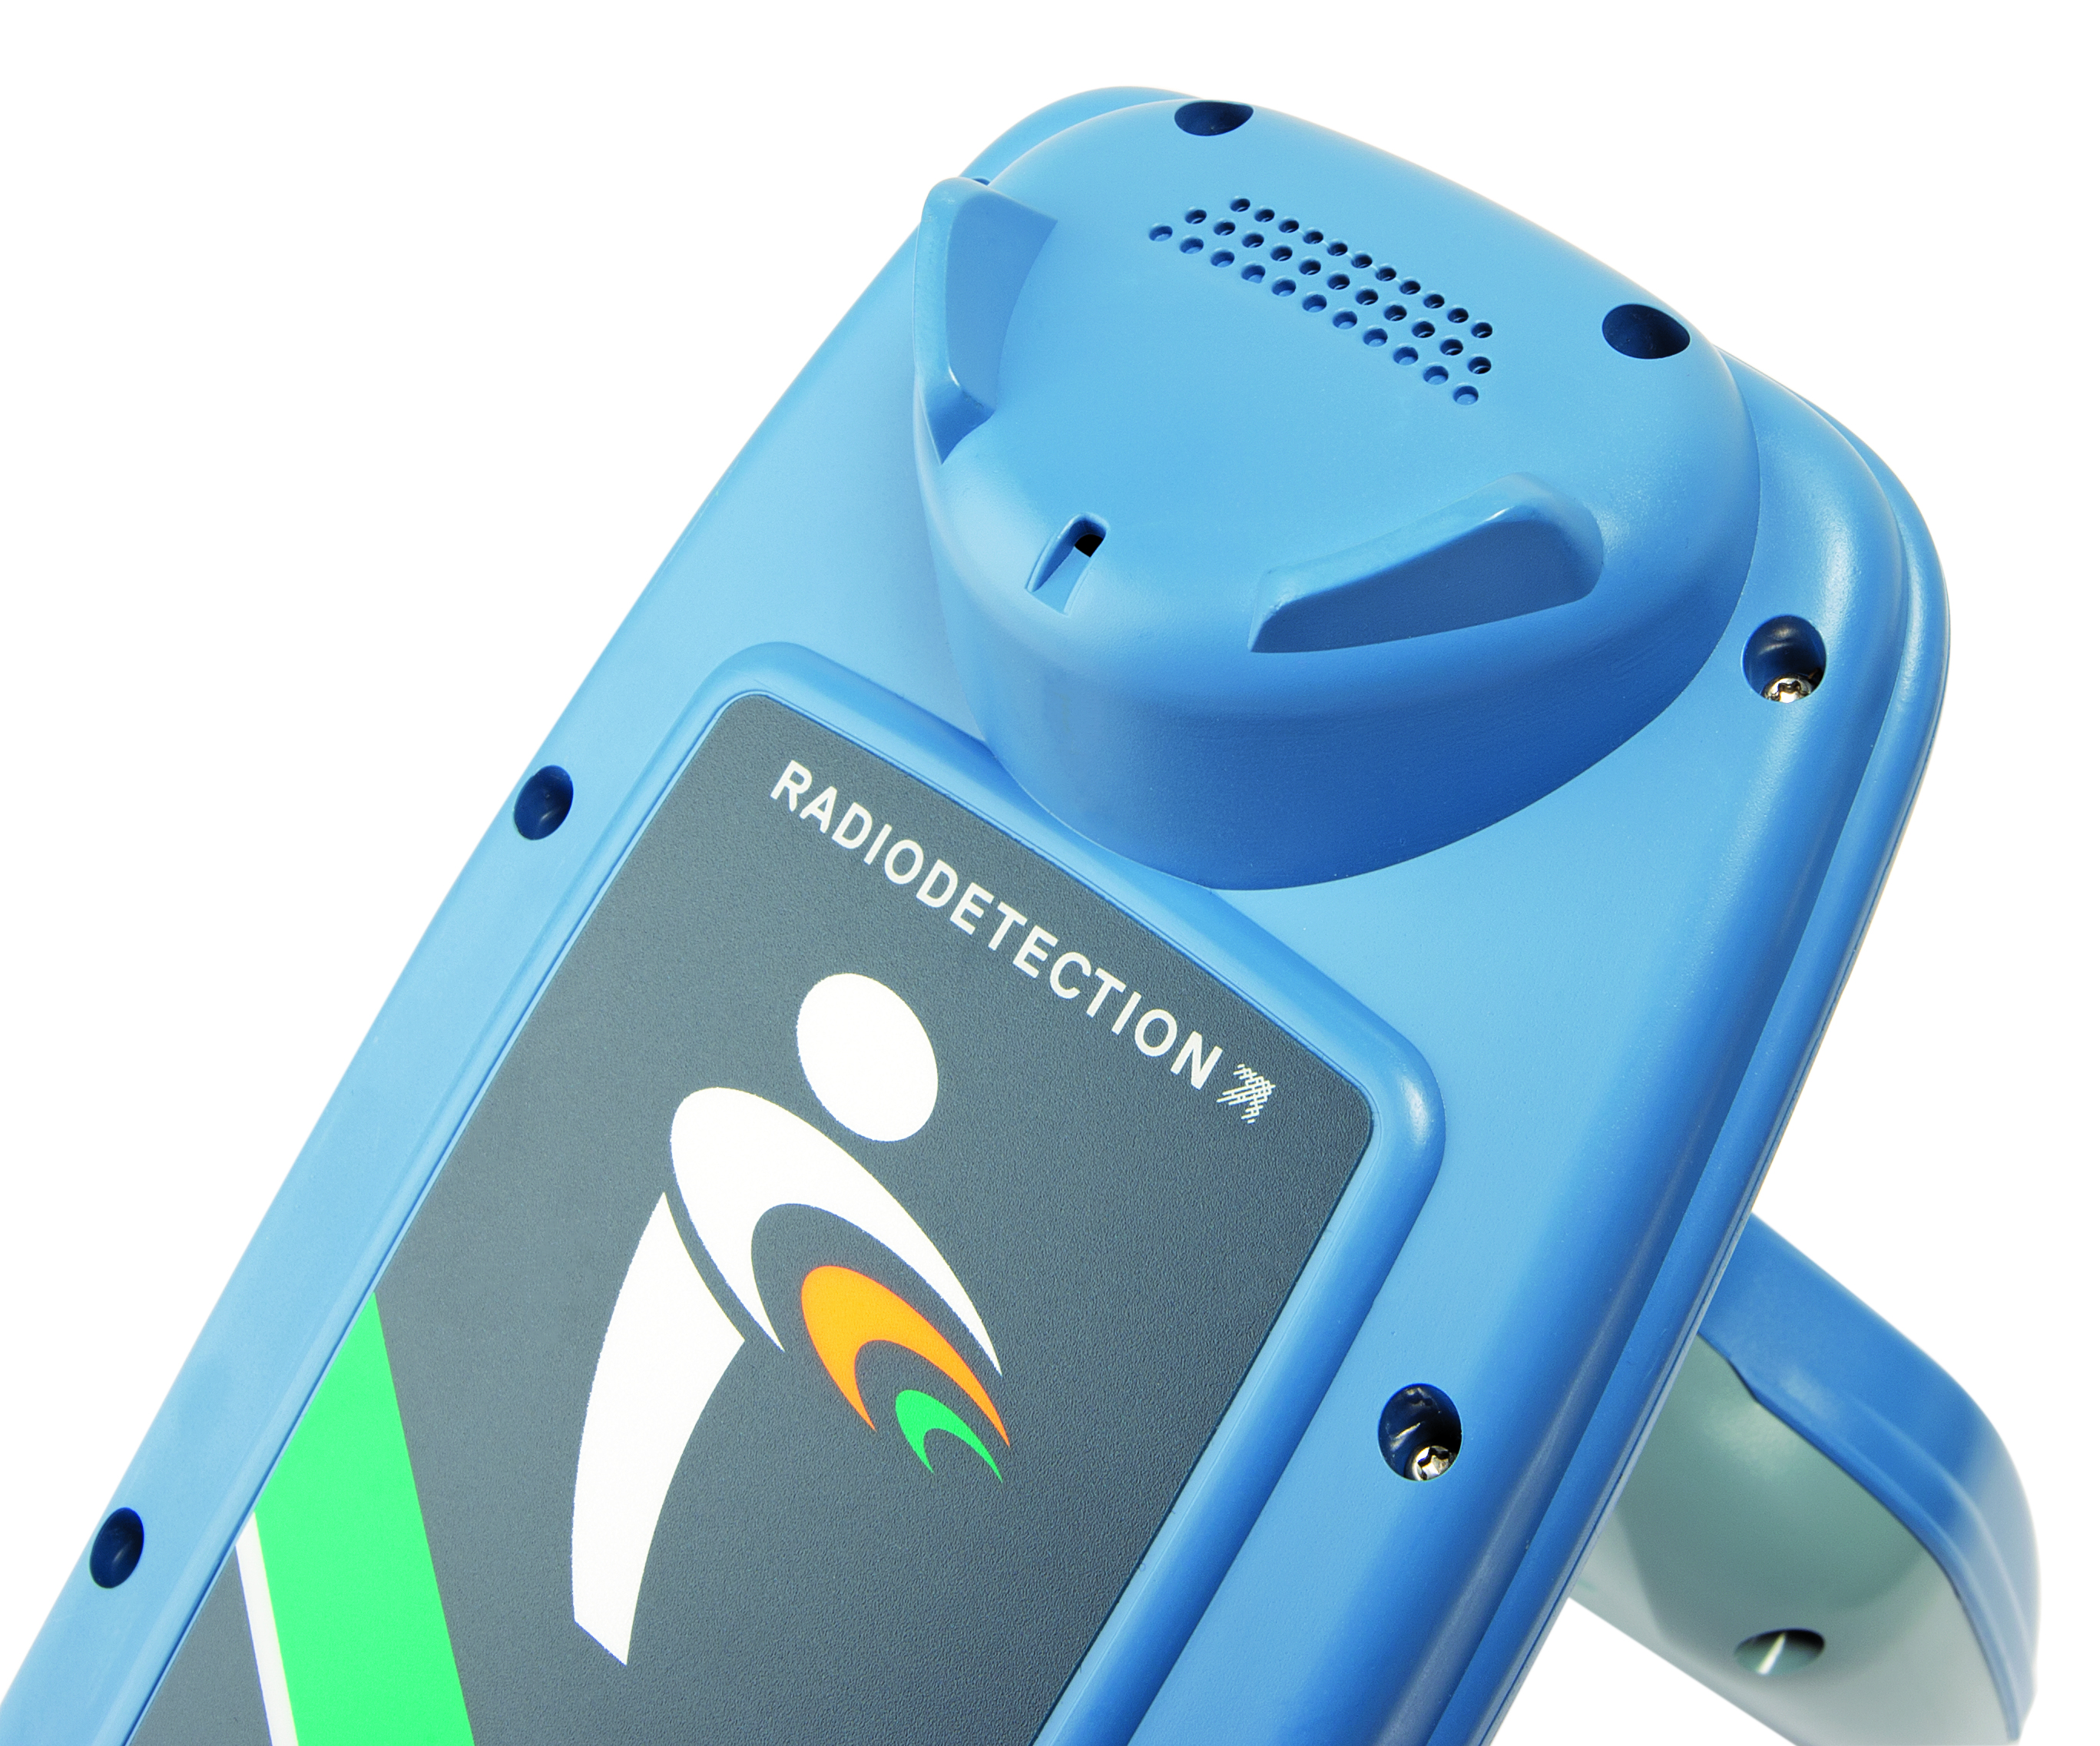
New Features
Swing Warning System to drive correct usage
Never miss a warning
Use in a noisy environment
Built-in swing measurement system, which alerts the user of excessive movement, driving correct usage
The handle vibrates when alerts activate, leaving the operator to concentrate on the job at hand
Waterproof speaker housing, provides maximum feedback to the operator.
5 power output levels assist technicians working in challenging environments
Sound Tone Selection
High/Low
(Select Audio in menu)

Slide 21
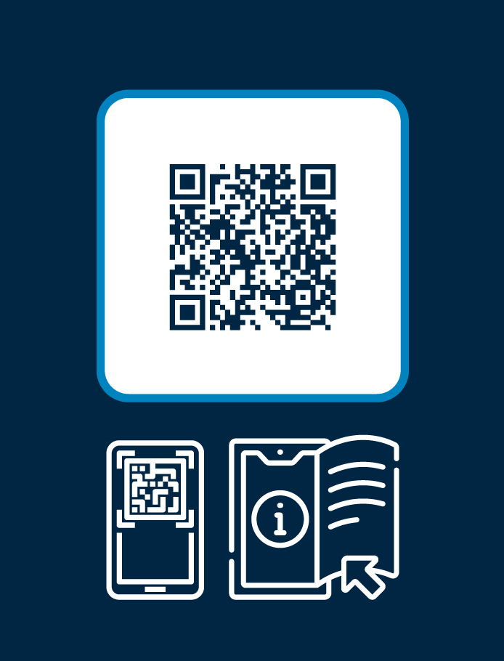
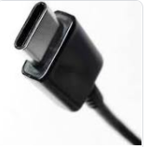
New Features
QR codes for instant on-site support and troubleshooting
USB Type C for easy USB connection
Bluetooth Low Energy for future upgrades and connectivity solutions
New GPS receiver and larger antenna for better accuracy

Slide 22
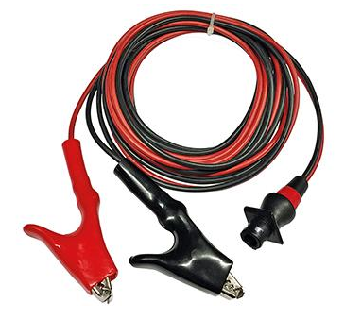
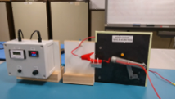
Improved DC Leads
We have created our own standard to prepare products for simulated field use
Extensive research and testing to ensure Quality
Only genuine 8200 leads have been through this test
Existing cable samples: 55 strands/0.15mm Rubber Jacket
Existing cable: FAILED @ 16,000 cycles
Existing cable (updated with improved strain relief): FAILED @ 57,000 cycles
New Cable test sample:259 strands / 0.07 UV stabilised PVC
Completed 100,000 cycles – Test stopped, no damage

Slide 23
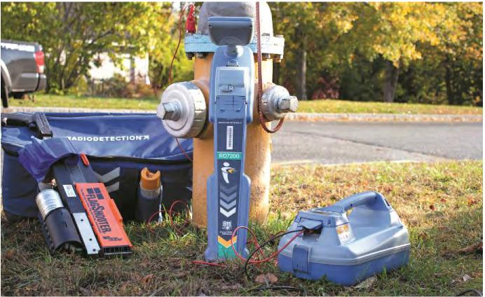
Ergonomic Design, Premium Quality
Radiodetection Locators are light yet rugged tools ready to operate in most difficult conditions, day after day.
Radiodetection help is always at hand with our online support website.
Made in the UK – No compromise on quality
Locate with confidence – Self-test
Use it all day, day after day – light weight and ergonomic
Sun or rain, hot or cold – works in harsh conditions
Extended warranty and Local Support
Remote calibration without downtime eCert™
Schedule your calibration – CALSafe™
Knowledge base and Technical support, when you need it
Radiodetection Locators
Are ready For A Connected World
with more
Exciting New Developments Coming Soon!

Slide 24
Offering Courses Covering:
Locators (Basic-Advanced)
Pipeline Current Mapping
Ground Penetrating Radar
Tracer Gas Leak Locating
Website
radiodetection.com
Technical Support Portal
support.radiodetection.com
Customer Service
1-207-655-8525
E-mail:
rd.sales.us@spx.com
Email: ken.wright@spx.com for pricing and details
Copyright © 2020 SPX Radiodetection. All rights reserved.
Notes:
Questions?

